Slide 1
Game Development 2B
The Factory Pattern

Slide 2

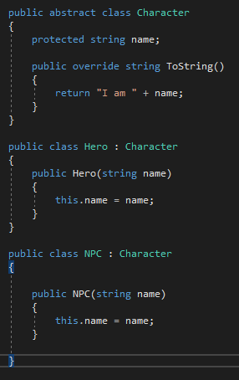
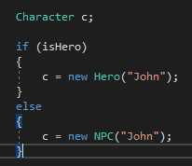
Instantiating class objects
Usually, we have to instantiate an object of a class to use it
We then create custom instances based on runtime calculations

Slide 3
the problem
Doing this makes maintenance an issue
What if you add a third Character type. We’d need to add more tracking Booleans as well as the new class
We’re trying to keep existing code as closed for modification as possible
As we extend, we’d need to fundamentally change any generation code

Slide 4
Creating factories
We can pull out this generation code into a separate class structure
This structure deals with what to generate, how to generate it, and returning that to our worker classes
Delegating code to the structure
Where have we dealt with this before?

Slide 5
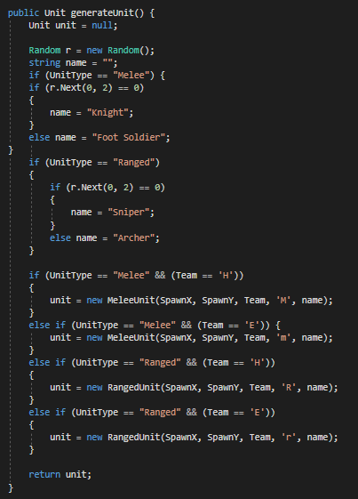
Factory buildings
Spawners are usually treated to some degree as a factory
You’ll subclass the different types of objects you want to spawn
The spawner then spawns objects of a type given some variable

Slide 6
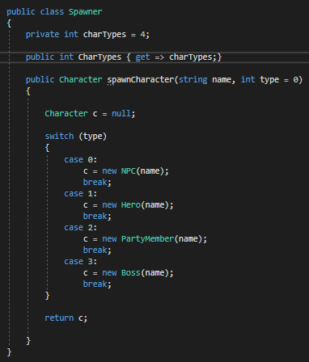
A simple factory

Slide 7
Changing our calling code
We now need a factory in our caller code that can spawn our units
1
We then use our factory to spawn those instances and put them somewhere so they get saved
2
Put as much info into Factory that can be used by calling methods as possible
3

Slide 8
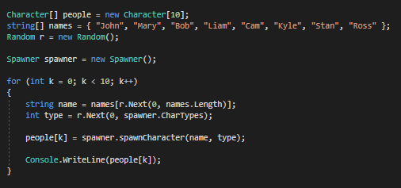
Working example code

Slide 9
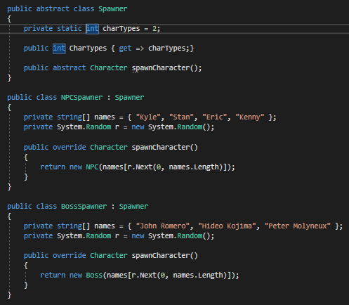
Further decoupling
You could make different kinds of Spawners (or Factories) for different objects
These would then deal with the creation of specific structured Characters (EnemySpawner, BossSpawner, NPCSpawner) in the case where spawn isn’t so simple
This will simplify our earlier example code when it comes to spawning

Slide 10
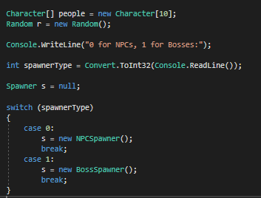
Basic setup
We no longer have to care about a list of names, this is handled on a per spawner basis
We just have to do some randomization of our spawner type before we create the units from a spawner

Slide 11
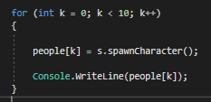
decoupling
Now, when we call s.SpawnCharacter(), at compile time, the function is completely decoupled
We have no idea what Spawner or Unit will Spawn
This decouipling allows decisions to be made at runtime by our users
We just have to code for the eventualities

Slide 12
Factory structures
Creator Classes
Spawner
NPCSpawner
BossSpawner
Product Classes
Character
NPC
Boss

Slide 13
Factory interactions
NPC Spawner makes NPCS
Boss Spawner makes Bosses

Slide 14
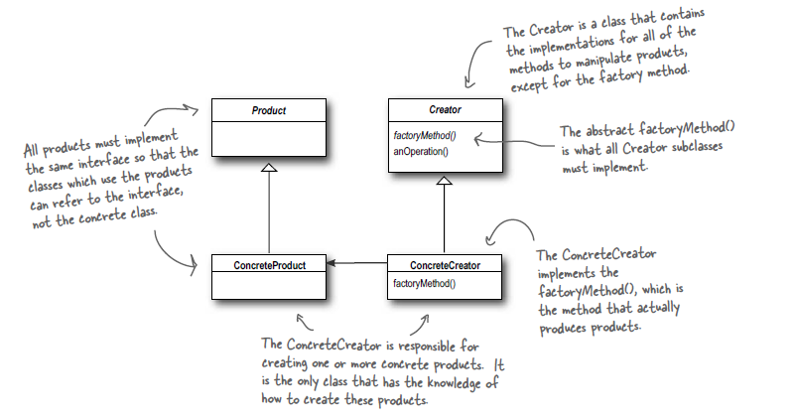
factory
The Factory Method Pattern defines an interface for creating an object, but lets subclasses decide which class to instantiate. Factory Method lets a class defer instantiation to subclasses.
Doing this creates decoupling
You begin to depend on the abstraction, not the concrete class
Your Spawner is abstract until you get information at runtime to define it

Slide 15
Dependency inversion
This is called Dependency Inversion
In standard dependency, NPC and Boss rely on Character, because they subclass it
Now, with this implementation, Spawner depends on Character too because its most important method, spawnCharacter MUST return a concrete object somehow
In Spawner subclasses, respective spawners must delegate correctly to return objects

Slide 16
Abstract factory
An extension of Factories that have a number of different factories inside them to do additional delegation
All those factories come together to form different parts of the same product
A factory of factories
This is useful for creating a number of components that then build up larger objects

